Slide 1
Managing Files

Slide 2
Today’s Plan
Controlling Files (Chapter 3, Elementary Information Security)
File system and access rights
Executable files
Viruses and malware
Sharing Files (Chapters 3 and 4, Elementary Information Security)
Policies for file protection
File Permission Flags
Access Control Lists
DEMO/Intro to Python
Lab 4

Slide 3
Controlling (accessing) Files

Slide 4
The File System
How we guarantee users a proper restricted access?
Similar problem to RAM access (weeks 2&3).
Solution: hierarchical directories
Organise files in groups
Tree structure with the root directory as parent
In Windows, each driver has its own root (C:\, D:\, …).
In Unix-based, the system provides the root.
If a file is not in the root, then it we need a directory path to find it (C:\Documents\...)

Slide 5
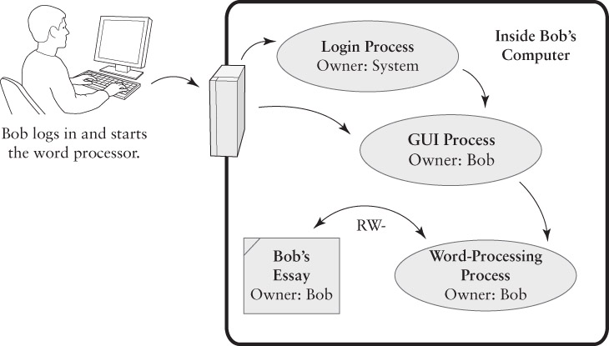
File Ownership and Access Rights
If Bob has an essay in his computer, how can he access it without other users to interfere?
The word processor takes on Bob’s user identity to create and modify files in his behalf.

Slide 6
File Access Rights
CRUD → Four types of rights:
Create
Read
Update (or write)
Delete
Plus append and execute.
To protect a newly created file, an OS tends to implement one of the following strategies:
Default rights — Apply the same access rights to all new files).
Inherited rights — Apply based on the enclosing directory.

Slide 7
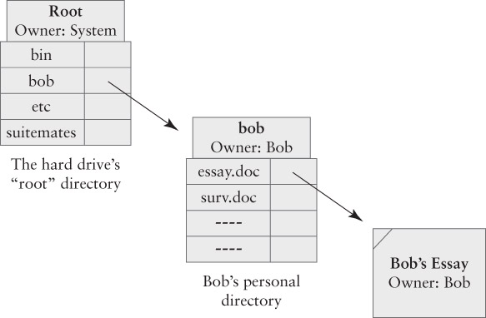
Directory Access Rights
We don’t have full control over a file unless we have the right to change its directory entry.
Bob’s essay location.
Bob’s personal directory (in root).
To find file, Bob starts at root. Then, process looks for bob, and finds the file inside.

Slide 8
Directory Access Rights
Three basic access rights:
Read, Write and Seek.
Bob can ______ in his directory.
Bob can ______ in the root, but may not _____.
Six specific rights:
Create (Dir/File)
Delete (Dir/File)
Read
Seek.
If the six are implemented, the system can achieve a Least Privilege high degree.
Notes:
-Seek: Look in a directory for a specific file.
-Read: List and seek.
-Bob can do read, write and seek in his directory.
-Bob can seek the root, but may not read (OS may consider there’s no need to list) and write (if he could, then he could erase other people’s files).

Slide 9
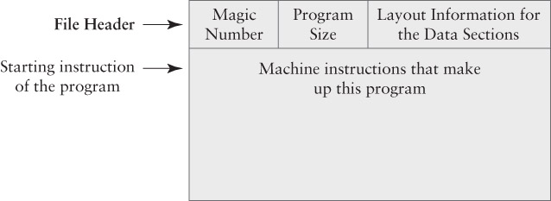
Executable Files
Contain application programs or other programs.
Instructions to be executed by the CPU (RAM control section).
Typical structure of an exe:
Addresses and offsets to lay out variables and stack locations in the program’s data section.
Structure and format.
Standard data value
(check).
When executing the program in a file, OS loads this instructions in the control section.
Size of machine instructions.

Slide 10
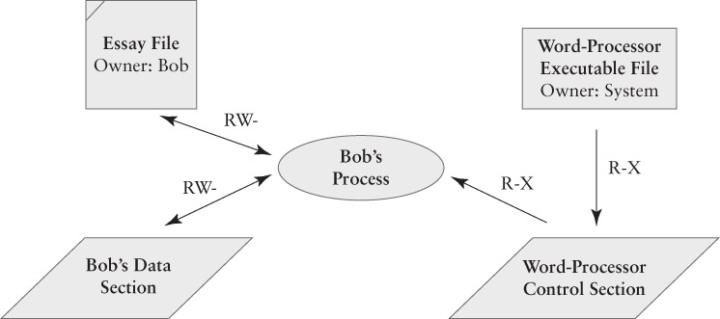
Execution Access Rights
What happens when you execute a program (i.e. Word) to edit a file (i.e. .docx)?
Files
STEP 3: Bob starts program and the file is copied by the process for its edition.
STEP 1: System reads .exe into control section.
Why no one has RWX?
X = Execution right
STEP 2: The process uses Bob’s data section to store parts of the file.
Notes:
-Why no one has RWX? Only the programmer would!

Slide 11

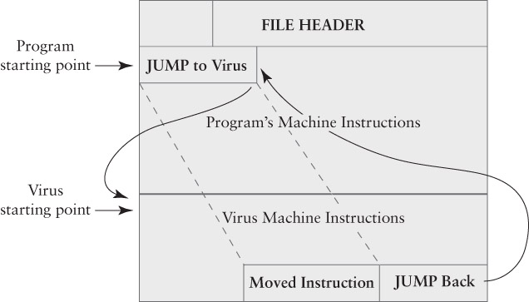
Viruses and Malware
What happened when a program gets “infected” by a virus and becomes malicious software?
VIRUS MACHINE INSTRUCTIONS
Search OS file directory for every file containing an application program.
Skip any infected files.
Not infected, copy exe instructions to the end of the file.
Modify first instruction to “Jump to Virus” + save first instruction.
Jump back to application program.
Is this behaviour bad per se?
Notes:
While the initial purpose of computer viruses was simply to test replicability, an incorrect assumption of the structure of an application could damage it unintentionally.

Slide 12
Sharing (and protecting) Files

Slide 13
Sharing and Protecting Files
Objectives:
Provide controlled access for a specific user.
Preserve the Chain of Control.
Permit or prevent general sharing among users.
Aims to prevent accidental and (some) malicious acts fro damaging files/processes.

Slide 14

Global Policies
File permissions to apply by default.
Determines the permissions to apply to new files.
Two types:
Isolation: No access granted to other user’s files.
File-sharing: Read access granted to other user’s files.
To maintain Chain of Control, file-sharing must avoid system files.

Slide 15

Tailored Policies
According to specific cases (i.e. working on a common file).
Three types:
Privacy: Block all access to certain files in a sharing environment.
Shared reading: Grant read-only access to certain files in an isolation environment.
Shared updating: Grant full access to certain files in either environment.

Slide 16
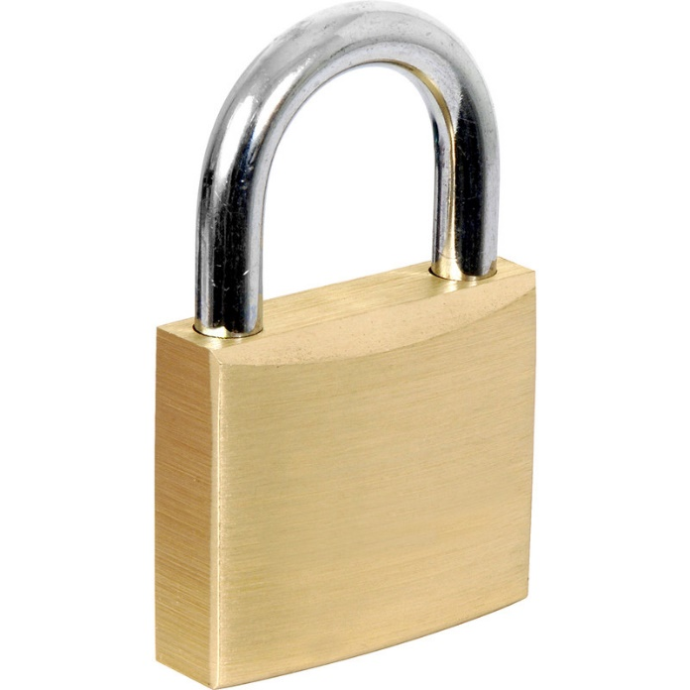
Security Controls
We can rely on the OS to protect files as long as:
The OS protections are always applied when we access our files.
There is no way to bypass the OS protections.
Basic Principle: Deny by Default
We always start by granting no access.
We add access rights.
This makes it easier to assign the right permissions and achieve Least Privilege.

Slide 17


Managing Access Rights
A full matrix of all files (rows) vs users-processes (columns) can be very long.
Windows has 13’000 files just for OS components!
Solution 1: Cluster by row (associate rights to files). → File Permissions
POSIX Standard.
Solution 2: Cluster by column (associate rights to users or processes). → Capability-based Security
Examples: FreeBSD, the POSIX standard.
Which one is “easier”?
Which is most common in OS?
Notes:
-The main difference between the two is who is the holder of the security.
-Solution 1 is like going to a restaurant and being asked for your reservation name, while solution 2 is like holding a ticket.
-The most common in practice is solution 1.

Slide 18
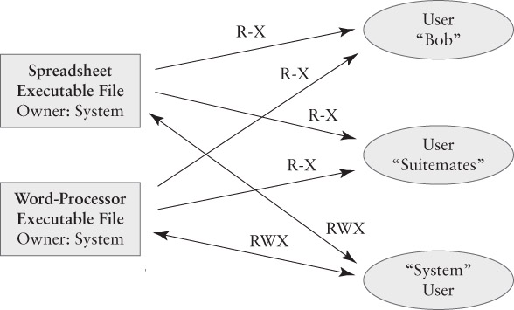
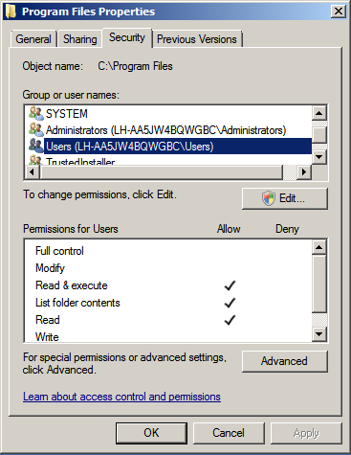
Access Rights for Executable Programs
File Permissions: Permission flags (Unix) or Access Control Lists (Win).
Notes:
There are three users: Bob, Suitemates and the System.
There are two executable files: Word and Excel.
Bob and the Suitemates can execute Word and Excel.
The System can do anything to these programs.
The files are the ones who grant access!

Slide 19
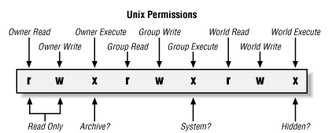
Permission Flags (Unix)
Each file has nine flags:
1-3: Read, write and execute for the file’s owner (“u”).
4-6: for users belonging to the group associated to the file owner (“g”).
7-9: for other users (“o”).
A flag is indicated as “–” when is false, otherwise the corresponding letter is used.
The command CHMOD (change mode) allows to raise/lower flags.
Other cases:
OpenVMS: 4X4
Notes:
-Other systems like OpenVMS use a fourth group for the system and a fourth flag for deletion.

Slide 20
Permission Flags (Unix): Examples
$ ls -l
-rw-r--r--@ 1 rick ops 4321 Nov 23 08:58 data1.txt
-rwxr-xr-x 1 rick ops 12588 Nov 23 10:19 hello
-rw-r--r--@ 1 rick rick 59 Nov 23 10:18 hello.c
Ignore first hyphen.
First file is owned by rick and is identified by the ops group. It has the identifier 4321, was created on Nov 23 @ 8:58 and is called “data1.txt”. It has default flags (the user that owns it can read and write, and both its group and other users can only read it.).
Second file (an executable) has same owners, but rick can do anything to it while the group and the world can read it and execute it. This permission is set by using the command CHMOD 755.
Third file is owned by rick, and can only be written by him.

Slide 21
Access Control Lists
The general purpose technique is to cluster access rights by row.
Permission flags require a small, fixed amount of storage for each file.
ACLs are an alternative to user groups:
We simply keep a list of individuals with the right to access a particular file or folder.
Efficient if each file needs its own tailored list.
Problem: ACLs may be arbitrarily long (challenge for the OS).

Slide 22
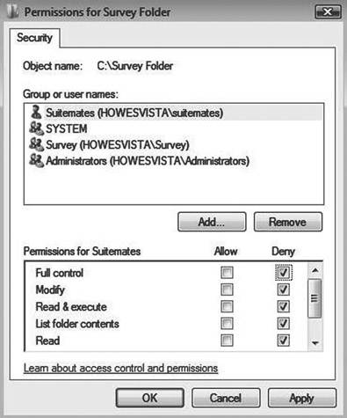
Windows ACLs
Present in “Professional,” “Business”, or “Enterprise” versions of Windows:
“Home” and “Basic” versions use simpler access lists.
Each ACL entry gives permission for a specific user or group:
Users and groups are defined on the computer or by a network-wide “Domain”.
Each entry specifies a list of permissions.
Each permission can be “Allowed” or “Denied”.

Slide 23
Building Effective ACLs
Deny by Default:
Start with no rights, or a small set of default ones.
Permissions to owner and administrators.
Add “Allow” rights as needed.
Keep the rules as simple as possible.
Example that needs a “Deny” right.
A group of all students called “Students”.
Need a group “Students Minus Freshmen”?
Easiest approach: Deny “Freshmen” group!

Slide 24
Permission flags (UNIX) vs ACLs (Windows)
user_1 from the Local group sets the following rights:
User user_1 has full access to the file.
Group Local has unspecified access.
Others have read-only access.
What will user_2 from the Local group be capable to do?
Notes:
-user_2 is part of the Local group but also part of the world!
-UNIX has DENY BY DEFAULT policy, therefore the Local group would have no access to the file and thus, user_2.
-In contrast, Windows ACLs have a combining approach since the allow and deny flags are separate. Therefore, the Local group would have read-only rights, such as user_2.

Slide 25
DEMO/Intro to Python

Slide 26
Lab 4: Creating Nested Virtual Machines
ADDITIONAL RECOMMENDATIONS FOR THIS WEEK
Shell scripting.
Read Chapters 3 – 4 from the text book.
Play with permission flags for files in Linux (i.e. use lab 3 files).
Download Python/Anaconda + find tutorials.

